Slide 1
Terraform en Azure
From Zero to Hero

Slide 2
Introduction

Slide 3
What is Terraform
IAC Tool
Developed by Hashicorp in GO Language
Uses HCL, it’s own declarative Language

Slide 4
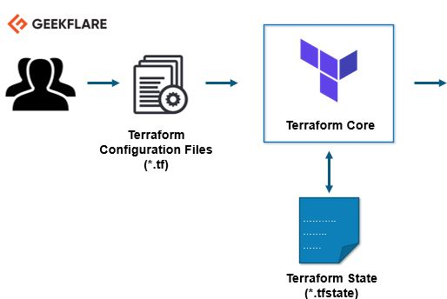



Terraform Architecture
Providers
Provisioners
Golang
Client Library
HTTPS
Notes:
Mas de 2900 Providers
35 providers oficiales.
+250 de partners.
Resto de comunidad.
https://registry.terraform.io/browse/providers?tier=official

Slide 5
Basic Commands
Terraform init: Initializes state, downloads providers, modules, etc.
Terraform Plan: Build work plan, to know wich infrastructure to deploy, change or remove
Terraform apply: Deploys infrastructure defined in ‘work plan’
Terraform destroy: Removes al the infrastructure defined in .tf files

Slide 6
Laboratories

Slide 7
Prerrequisites
GIT
VSCode
Terraform extension
Azure Terraform extension
Azure CLI
Terraform
Azure DevOps account - import -> clone
Azure subscription

Slide 8
Agenda
Laboratory 1 (basics) – 45 min
Laboratory 2 (variables) – 45 min
Laboratory 3 (modules) 30 min.

Slide 9
Resources
Laboratories URL
https://github.com/luiselopezlopez/TerraformLab
Documentation
https://registry.terraform.io/providers/hashicorp/azurerm/latest/docs
More Labs
https://github.com/JimPaine/azure-terraform-lab/

Slide 10

Al turron!!!

